Slide 1
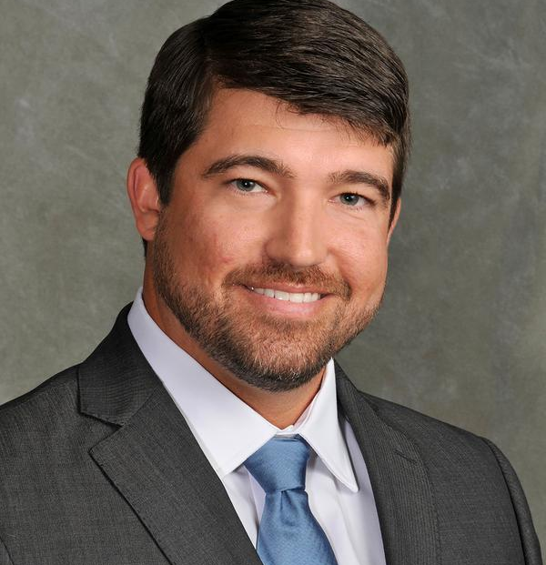
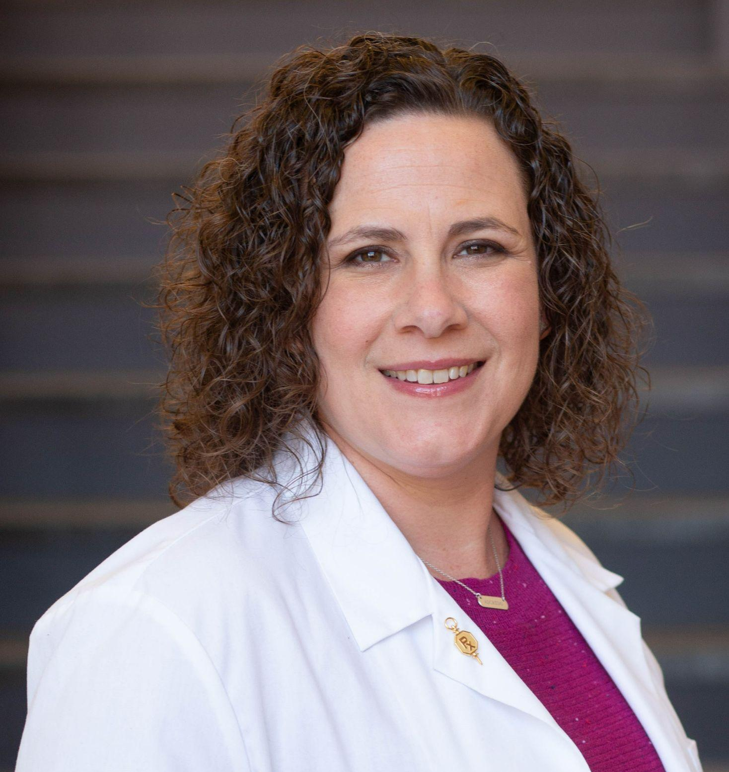
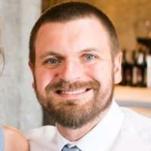
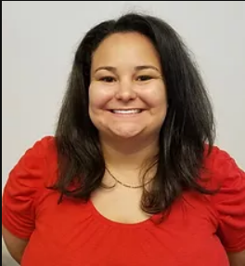
PASA Student Debt Panel
Thursday, February 17th at 6pm
Learn how to pay off your student loans from CPHS alumni!
Join us using this link!
Dr. Ryan Williams, PharmD
Dr. Susan Blanton, PharmD
Dr. Jonathan Harward, PharmD
Julia Niemi, PA/MSPH

