Slide 1
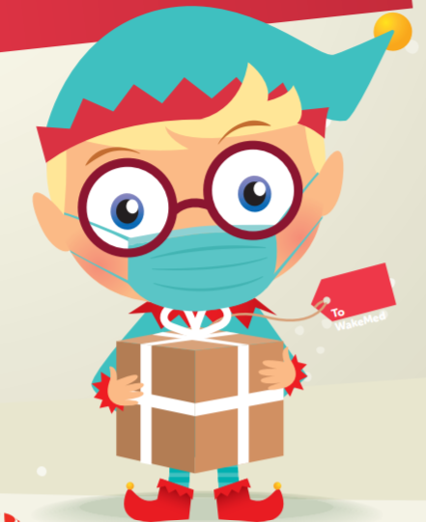
Campbell University - NCODA PSO
Christmas
Drive
ACCEPTING DONATIONS THROUGH
FRIDAY
DECEMBER 17th
Please reach out for more info
Click here for a list of items you can donate
All donations must be NEW

