Slide 1
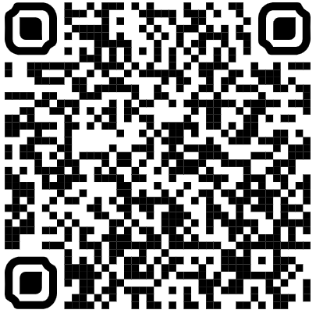
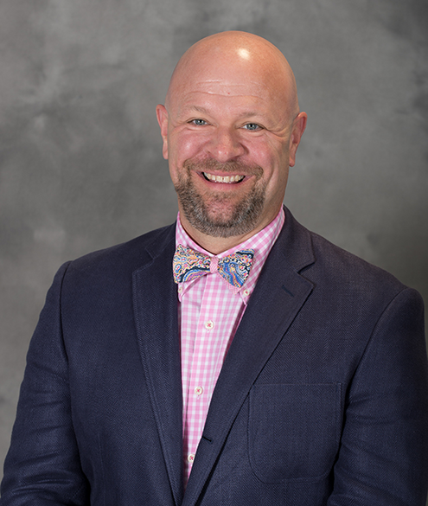
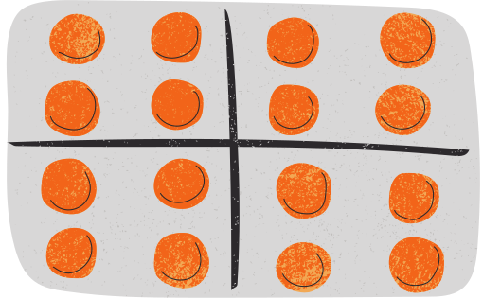
Monday, November 15, 12 PM in Maddox 225
NCPA General Meeting
Dr. Andy Bowman will be discussing the recent
updates in community pharmacy legislation!
Sign-up Here
for Lunch!

