Slide 1
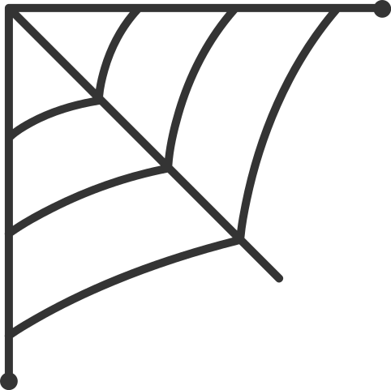
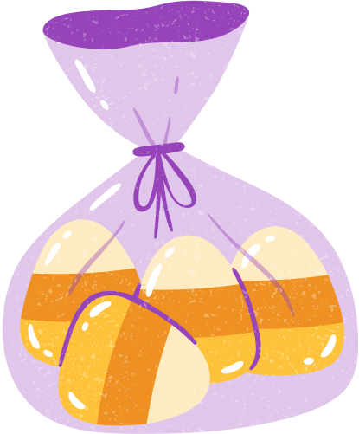
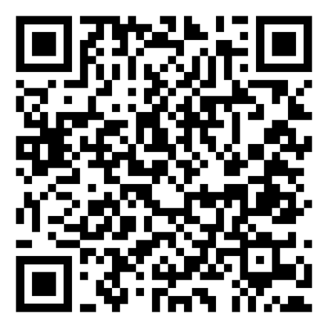
National Community Pharmacists Association (NCPA) presents:
BOO GRAMS
On sale from October 11th - October 25th
Cost: $2.00 each
Use the QR code below to fill out the order form and pay!
Benefiting:

