Slide 1
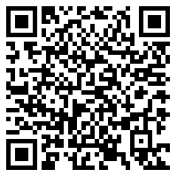
Phi Delta Chi & St. Jude 50/50 Raffle
Monday, September 20th – Friday, October 1st at 11pm
$2 per ticket or purchase more for multiple entries!
50% of the proceeds will go to the winner and 50% will go to St. Jude Children's Research Hospital
Previous winners have won more than $1000!
WINNER TO BE ANNOUNCED ON OCTOBER 5TH!
Purchase tickets using the Touchnet Link here!
When purchasing a ticket, please include your name and email address.
If you are purchasing through a PDC Brother, please include their name in parenthesis next to your name.
Notes:
It will close at 11pm on Friday, October 1st.

