Slide 1
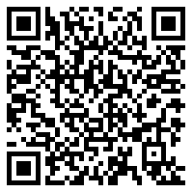
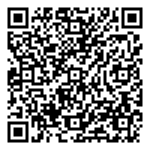
Benefits of Membership:
Great addition to your CV!
Attend the virtual ACCP annual meeting (Oct. 16th - 19th)
Learn more about various career paths in pharmacy
CV/LOI review services
Student programming for residency preparation
For more information click here
SCCP Dues
ACCP Dues
More Info!
*Join SCCP and ACCP by September 20th to be entered in a drawing for an SCCP blanket*
*Email the national dues receipt to Avery Mooring (andawson0813@email.campbell.edu)*
Click Here to Pay SCCP Dues: $15
Click Here to Pay ACCP Dues: $45

