Slide 1
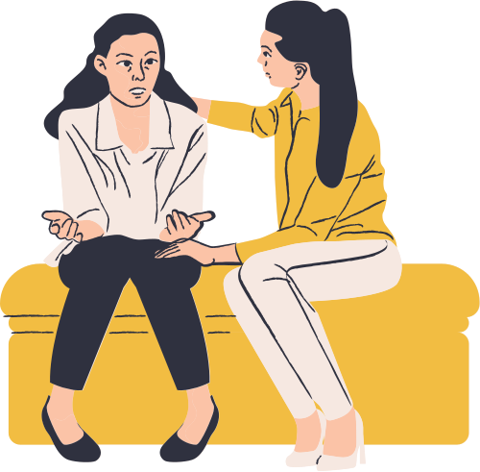
Behavioral Health- Campbell University
Presentation by Marisa Hurst

Slide 2
Counseling Services
Behavioral Health
vs
**For undergraduate students ONLY
**main campus
**For CPHS, DO and MSBS students
**through the School of Osteopathic Medicine (Levine)

Slide 3
With your Campbell tuition you have access to unlimited free, confidential psychotherapy sessions
Monday-Friday 9am-6pm (they will work with your schedule)
Variety of Clinicians- therapy only
In-person (Levine Hall) and Virtual

Slide 4
How do I make an appointment?
email CUSOMBH@campbell.edu (Teresa)

Slide 5
EVERYONE CAN BENEFIT FROM THERAPY
Everyone has their "something". Do not wait until it is too late to get help.
Variety of Topics
Academic difficulty/ performance, burnout, study strategies, anxiety, depression, relationship/ family difficulties, adjustment to lifestyle changes, stress and anger management and more
Connection to further treatment
psychiatry, alternative treatment options , other referrals, etc
"But I don't need therapy"
If you are even considering it, send the email!
The waitlist can get long. Just because you reached out, does not mean you have to go through with it

Slide 6
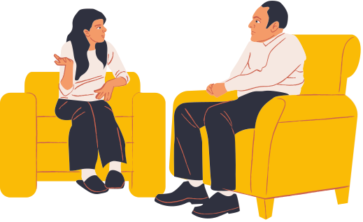
What other resources are there?
MYGroup Student Assistant Program (SAP)
FREE 24/7 counseling services for CPHS students PLUS
legal assistance
financial counseling
stress management
and more!
App, website or call (refer to Steph Olsen's email from 11/01/2022

Slide 7
Initial phone call to SAP
Meet with counselor for assessment session/s (typically, 1-2 sessions)
Needs
Intake Call
Assessment
Develop Problem Resolution Plan
Based on detailed assessment for which short- term therapy recommended, go forward with additional sessions under SAP model.
Based on detailed assessment for which issue determined to be long-term, referred out of SAP for therapy and/or appropriate resources.
Short-Term Solution-Focused Counseling
Referral to Appropriate Resource(s)
mygroup.com

Slide 8
Any Questions?
315-729-0402

