Slide 1
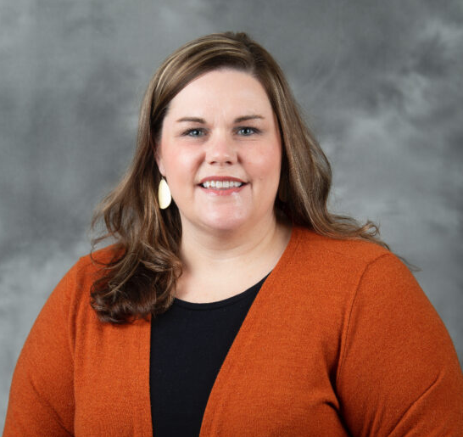
PASA Virtual Meeting
Thursday, January 27th at 6PM
Learn important interview tips and tricks from Dr. Paige Brown!
Join the meeting using this link!

