Slide 1
Health Policy & Professional Practice
Professionalism & Emotional Intelligence
Laura Gerstner, PA-C
Special thanks to Dr. Ward

Slide 2
Objectives
Following completion of this lecture and the assigned reading, students should be able to:
List examples of exemplary and lapses in professional conduct in the medical field.
Realize the importance of emotional intelligence (EI) in successful professional careers, especially in medicine
Understand the major skills in EI:
self-assessment
self-management
Empathy
social skills
motivation
Recognize some strengths and weaknesses in their own emotional intelligence
Describe ways to help learn the skills of emotional intelligence

Slide 3
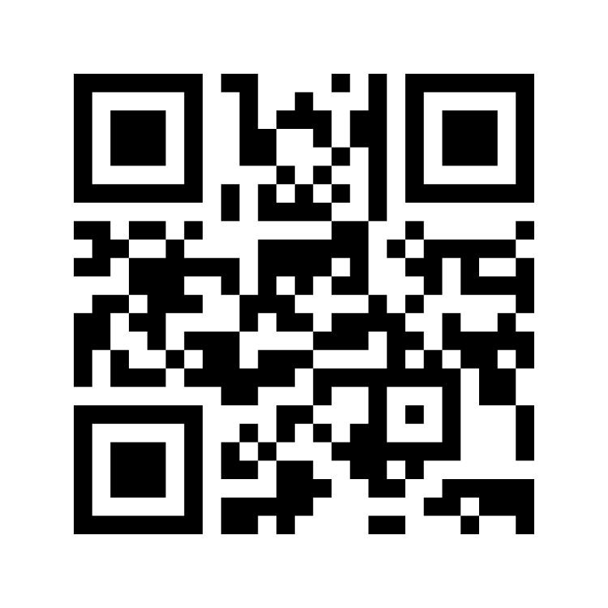
First question….
https://www.menti.com/vp6s23rs5f

Slide 4
Second question…
Why do we introduce & expect professionalism while you are in PA school?
Notes:
Lapses in professionalism during a PA student’s clinical year are especially troubling as research has showna correlation between unprofessionalbehaviorin medical students and subsequent disciplinary action once in clinical practice.

Slide 5
7-minute small group activity Each student will be assigned to a group: 1-10
List examples of exemplary professional conduct relating to:
1 – clinical practice
2 – teamwork
3 – handling stress
4 – patient advocacy
5 – online content
List examples of lapses in professional conduct relating to:
6 – clinical practice
7 – teamwork
8 – handling stress
9– patient advocacy
10 – online content
https://docs.google.com/spreadsheets/d/1GPZgWJcCShlAjjk49FOIoC7qpy-DsEoNb5Oes26JySM/edit?usp=sharing

Slide 6
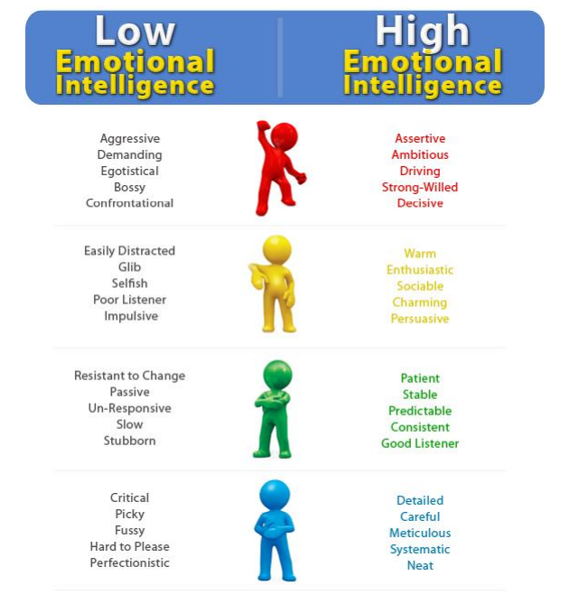
What Does Emotional Intelligence Look Like?

Slide 7
IQ Alone Does Not Explain Success
Performance in a variety of careers is attributable to emotional intelligence from 30% to 45% of the time
IQ accounts for 1% to 20% of career success
IQ determines what careers are open to us
but accounts for much less in terms of success within a career
IQ
EI
Reference: Stein & Book, 2011, The EQ Edge

Slide 8
Student Success and EI
Students with higher EI are more likely to make better grades, be retained, and graduate
Sparkman, Maulding & Roberts, 2012;
Mann & Kanoy, 2010;
Kanoy, 2011
among others!

Slide 9
Emotions
“Anyone can become angry - that is easy. But to be angry with the right person, to the right degree, at the right time, for the right purpose, and in the right way - this is not easy.”
Appropriateness of emotions
Development of emotion in the brain
ARISTOTLE, The Nicomachean Ethics

Slide 10
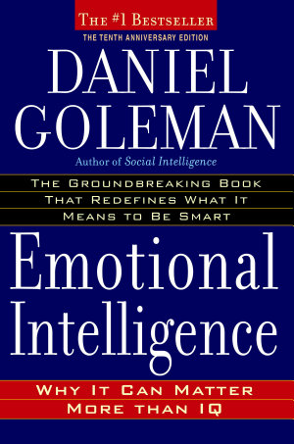
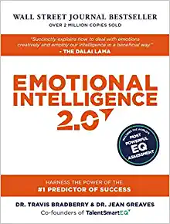
Keys to Emotional Intelligence
Self Awareness
Self Management
Social Awareness
Empathy/Relationship Management
Motivation

Slide 11
Emotional Intelligence Skills
Self Awareness
Self Management
Ability to recognize moods and emotions as they happen
Knowing one's strengths, weaknesses, drives, values and goals
Recognizing the impact of our emotions on others
Being able to use gut feelings to guide decisions.
Social Awareness
Empathy
Motivation
Hallmarks:
Self-confidence, realistic self-assessment, self-deprecating sense of humor

Slide 12
Emotional Intelligence Skills
Self Awareness
Self Management
Controlling or redirecting one's disruptive emotions
Controlling impulses
Adapting to changing circumstances
Thinking before acting
Social Awareness
Empathy
Motivation
Hallmarks:
Ability to bounce back from upsets, comfort with ambiguity, open to change

Slide 13
Emotional Intelligence Skills
Self Awareness
Self Management
Managing relationships
Moving people in the right direction
Ability to find common ground and build rapport
Social Awareness
Empathy
Motivation
Hallmarks:
Social stars, persuasiveness, good team-builder and leadership expertise

Slide 14
Emotional Intelligence Skills
Self Awareness
Self Management
Recognizing emotions in others
Seeing things in the other person’s shoes
Considering other people's feelings, especially when making decisions
Social Awareness
Empathy/Relationship Management
Motivation
Hallmarks:
Cross-cultural sensitivity, tolerance, good customer (patient) service

Slide 15
Emotional Intelligence Skills
Marshaling emotions for self-motivation
Curiosity and joy for learning
Strong sense of what is important in life
Being able to get into the “flow” state for maximum achievement
Self Awareness
Self Management
Social Awareness
Empathy
Motivation
Hallmarks:
Strong drive to achieve, optimism (even after failure), productive, organizational commitment

Slide 16
Emotional Intelligence involves a SET OF SKILLS that can be learned at any age

Slide 17
How did you score on the EQ assessment I had you take?
15-34: EQ needs work
35-55: EQ okay – could still use work
56-75: EQ is great!
Take a minute and think about ways you can improve your:
Self-awareness
Self-management
Social awareness
Empathy/relationships
Motivation

Slide 18
Learning Self-Awareness
Self Awareness
Self Management
Social Skill
Empathy
Observe your own thinking and emotions
At first, quietly and alone
With practice, as you interact
Distinguish thoughts, emotions and behaviors
Ask trusted friends for feedback
Write down your own goals and analyze your strengths and weaknesses
Do this from the perspective of others
Motivation

Slide 19
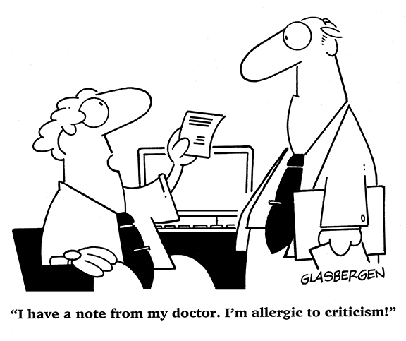
Learning Self-Management
Self Awareness
Self Management
Social Skill
Empathy
Observe your own behaviors, especially negative ones
Examples: getting angry, irritable, or worrying
Identify triggers and challenge your thoughts
Develop stress relief tactics
Use humor to defeat negativity
Use goals and delayed gratification to help impulse control
Set achievable goals and timeframes
Motivation

Slide 20
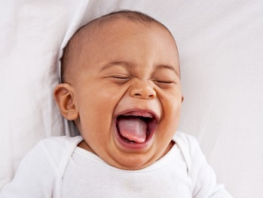
Learning Social Skills/Awareness
Smile!
Smile, make eye contact, introduce yourself, listen, express interest
Compliment people
Ask open-ended questions about other person
Stay up to date on current events
Observe and behave like a social person
Start small, “fake it until you make it”
Again, ask for feedback from a trusted friend
Self Awareness
Self Management
Social Skill
Empathy
Motivation

Slide 21
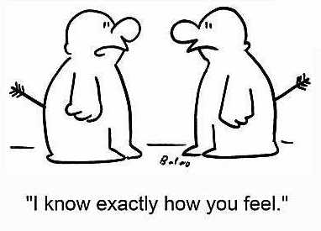
Learning Empathy
Self Awareness
Self Management
Social Skill
Empathy
Practice active listening
Have a genuine desire to understand the other person’s feelings and perspective
No judgment or defensiveness
Don’t interrupt
Watch their body language
Restate to ensure understanding
Share in other people’s joy
Respond to positive emotions like happiness and pride
Express enthusiasm when someone shares good news
Motivation
Look for shared identity
Look for sources of commonality
Look for shared experiences
If nothing else, you are both human and share daily human joys and trials
Read fiction
Or watch movies or plays
Practice immersing in another person’s experience
Pay attention to faces
Practice and improve your skills of emotion recognition.

Slide 22
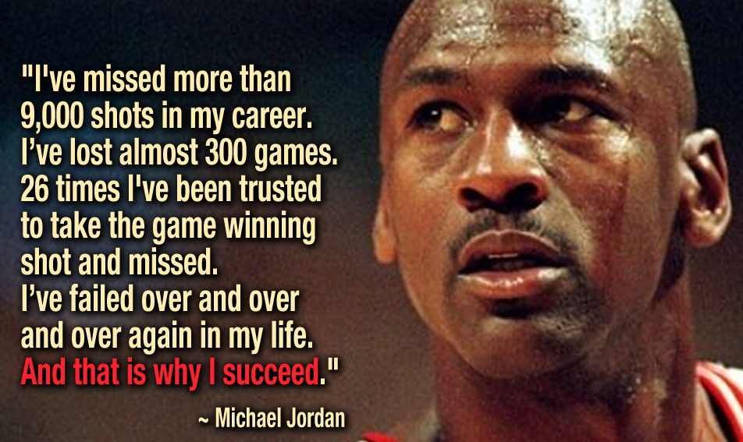
Learning Motivation
Self Awareness
Self Management
Social Skill
Empathy
Motivation
Keep good company
Stop thinking and just do it! Now!
Set goals and delay gratification
Get positive, get confident and get hungry
Only compete with yourself
Help others
Most successes follow many failures

Slide 23
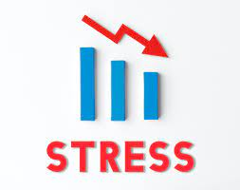
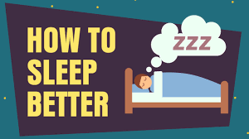
Additional ways to increase EQ…

Slide 24
Final question…
How do you think a person’s emotional intelligence may influence their professionalism?

Slide 25
Questions?

Slide 26
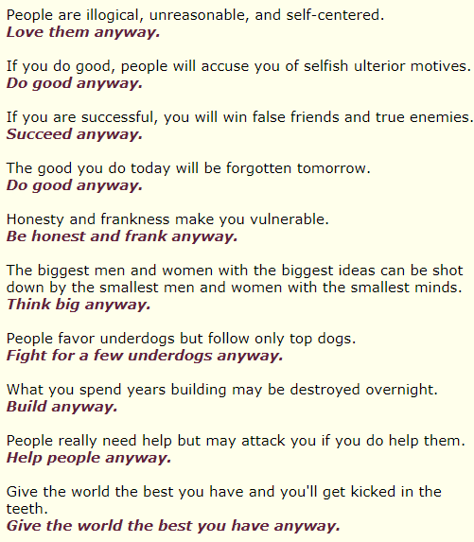
Thought For The Day
The Paradoxical Commandments by Kent M. Keith,
(hung on the wall in Mother Theresa’s clinic, a different version named “The Final Analysis” is often attributed to her)

Slide 27
References
Bradberry, T. & Greaves, J. (2009). Emotional intelligence 2.0. Talentsmart.
Cassidy, B.A. & Blessing, J.D. (2008). Ethics and professionalism: a guide for the Physician Assistant. F. A. Davis Company
Goleman, D. (2006). Emotional intelligence, 10th edition, why it can matter more than IQ. Bloomsbury.
Jonsen, A.R., Siegler, M., & Winslade, W.J. (2015). Clinical ethics: a practical approach to ethical decisions in clinical medicine, eight edition. McGraw Hill Education.

