Slide 1
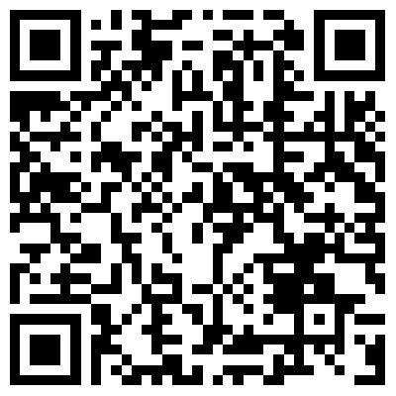
Lab Value Reference Card Sale!
Phi Delta Chi is hosting a lab value reference card fundraiser during the month of November. These cards (design shown below) list the reference ranges for common diagnostic lab tests! They are a great resource to have while on rotation and can be placed on a badge reel!
Each card is $6.00, and all proceeds will go to the Beta Kappa chapter of Phi Delta Chi!
Front
Order your
card here!
Back
Order yours before midnight on December 1st!

