Slide 1
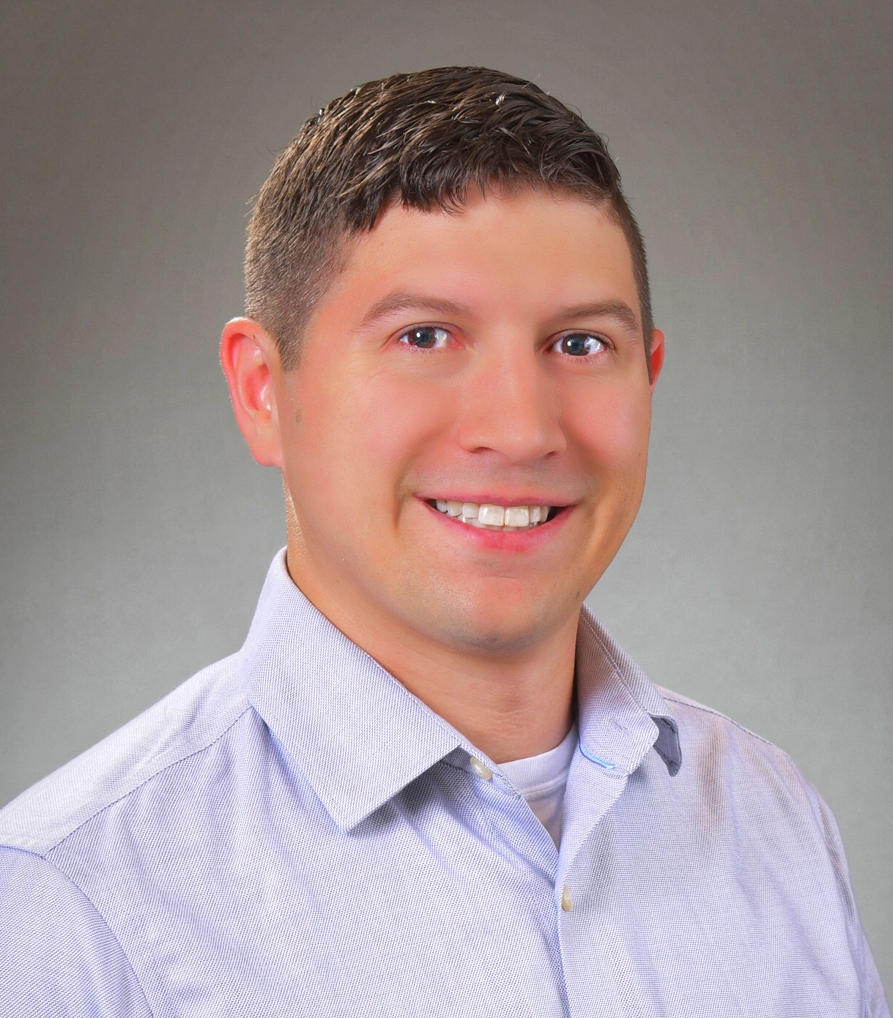
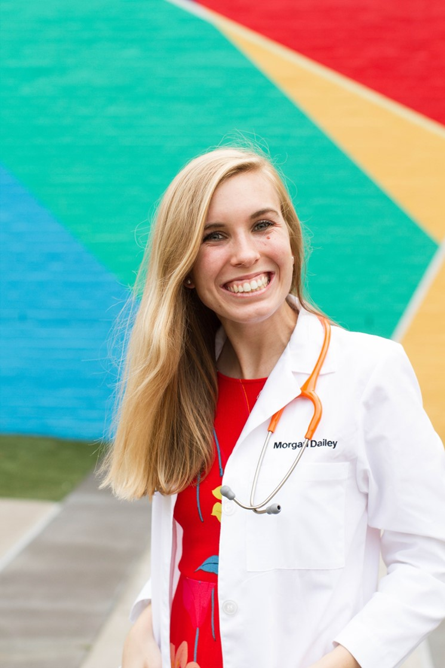
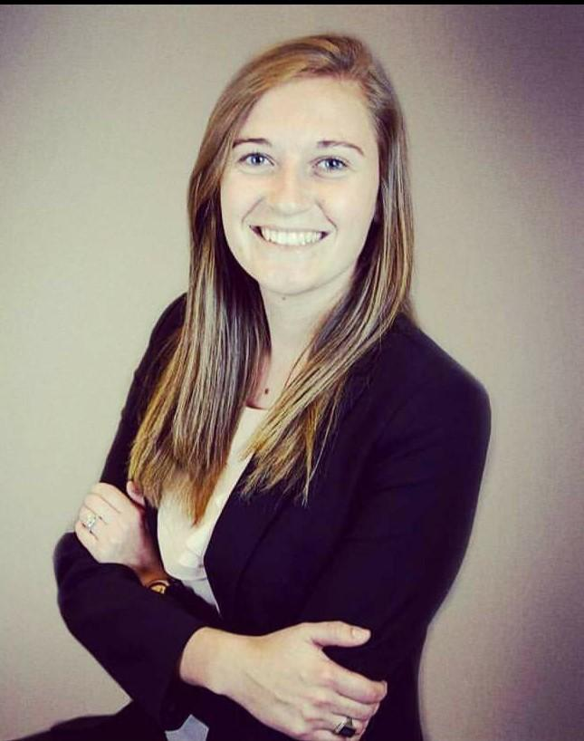
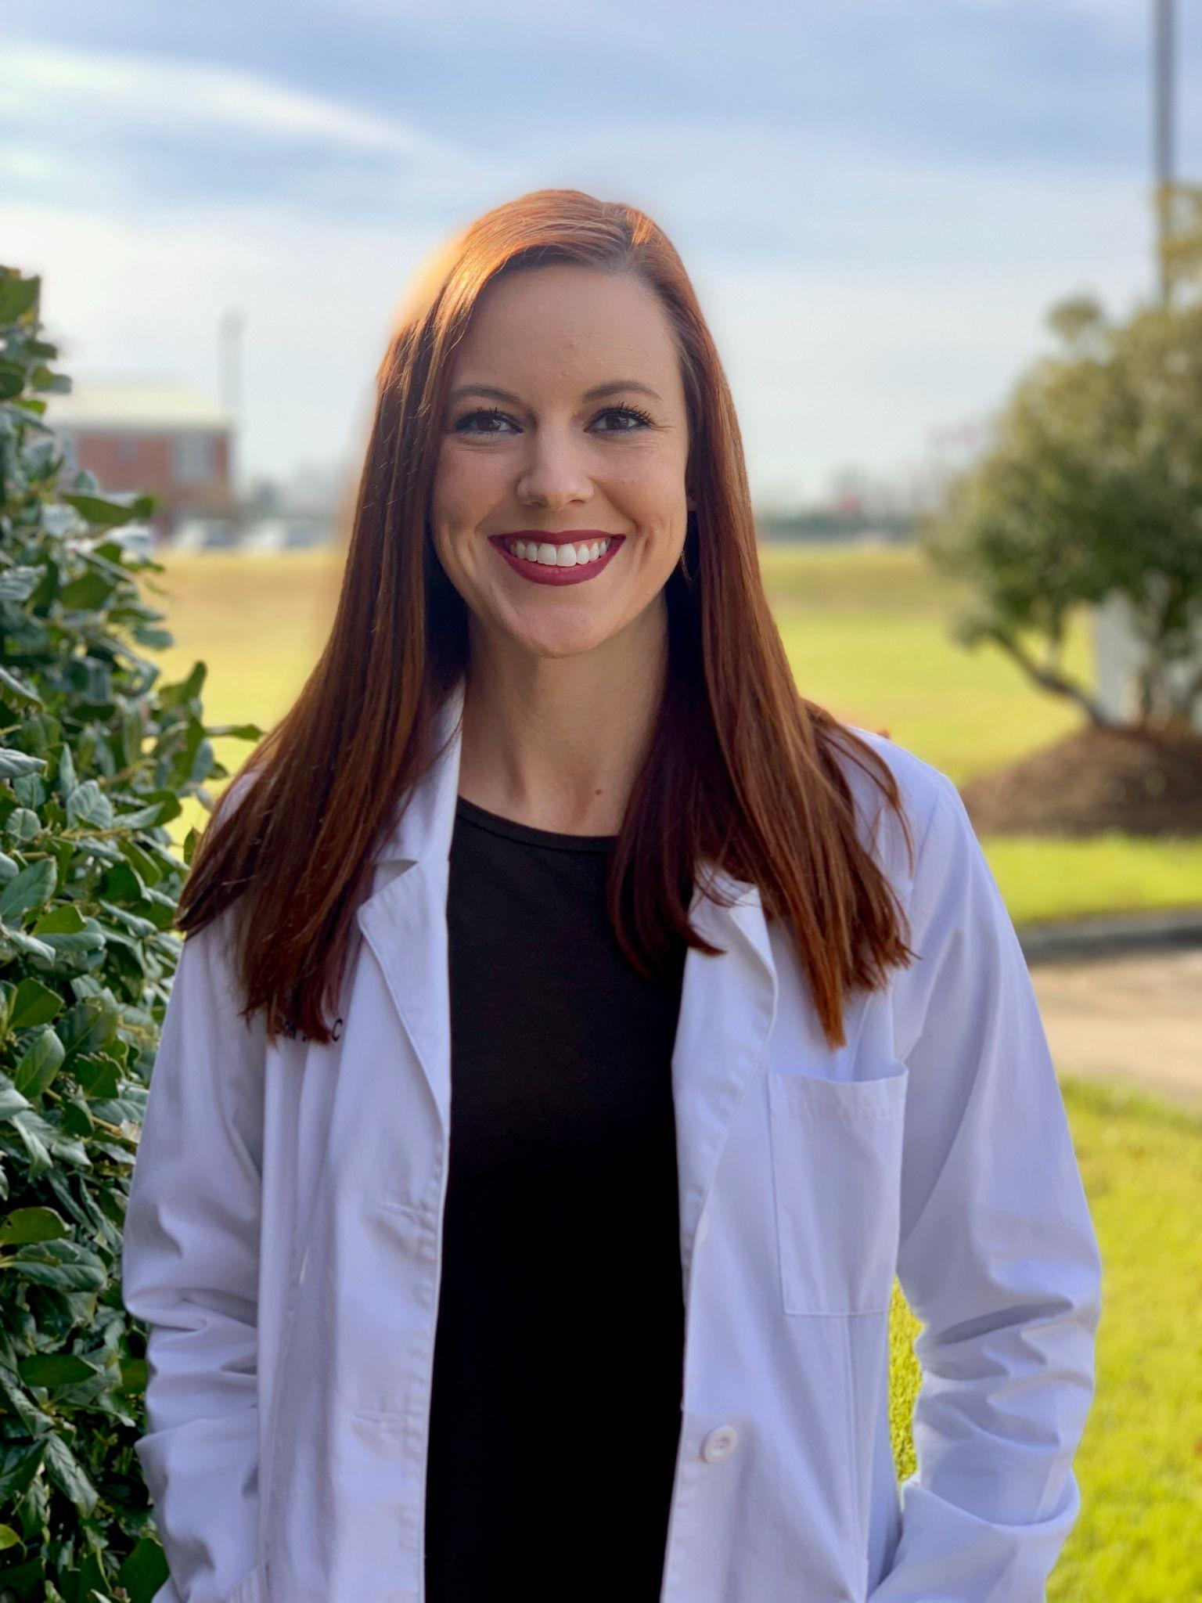
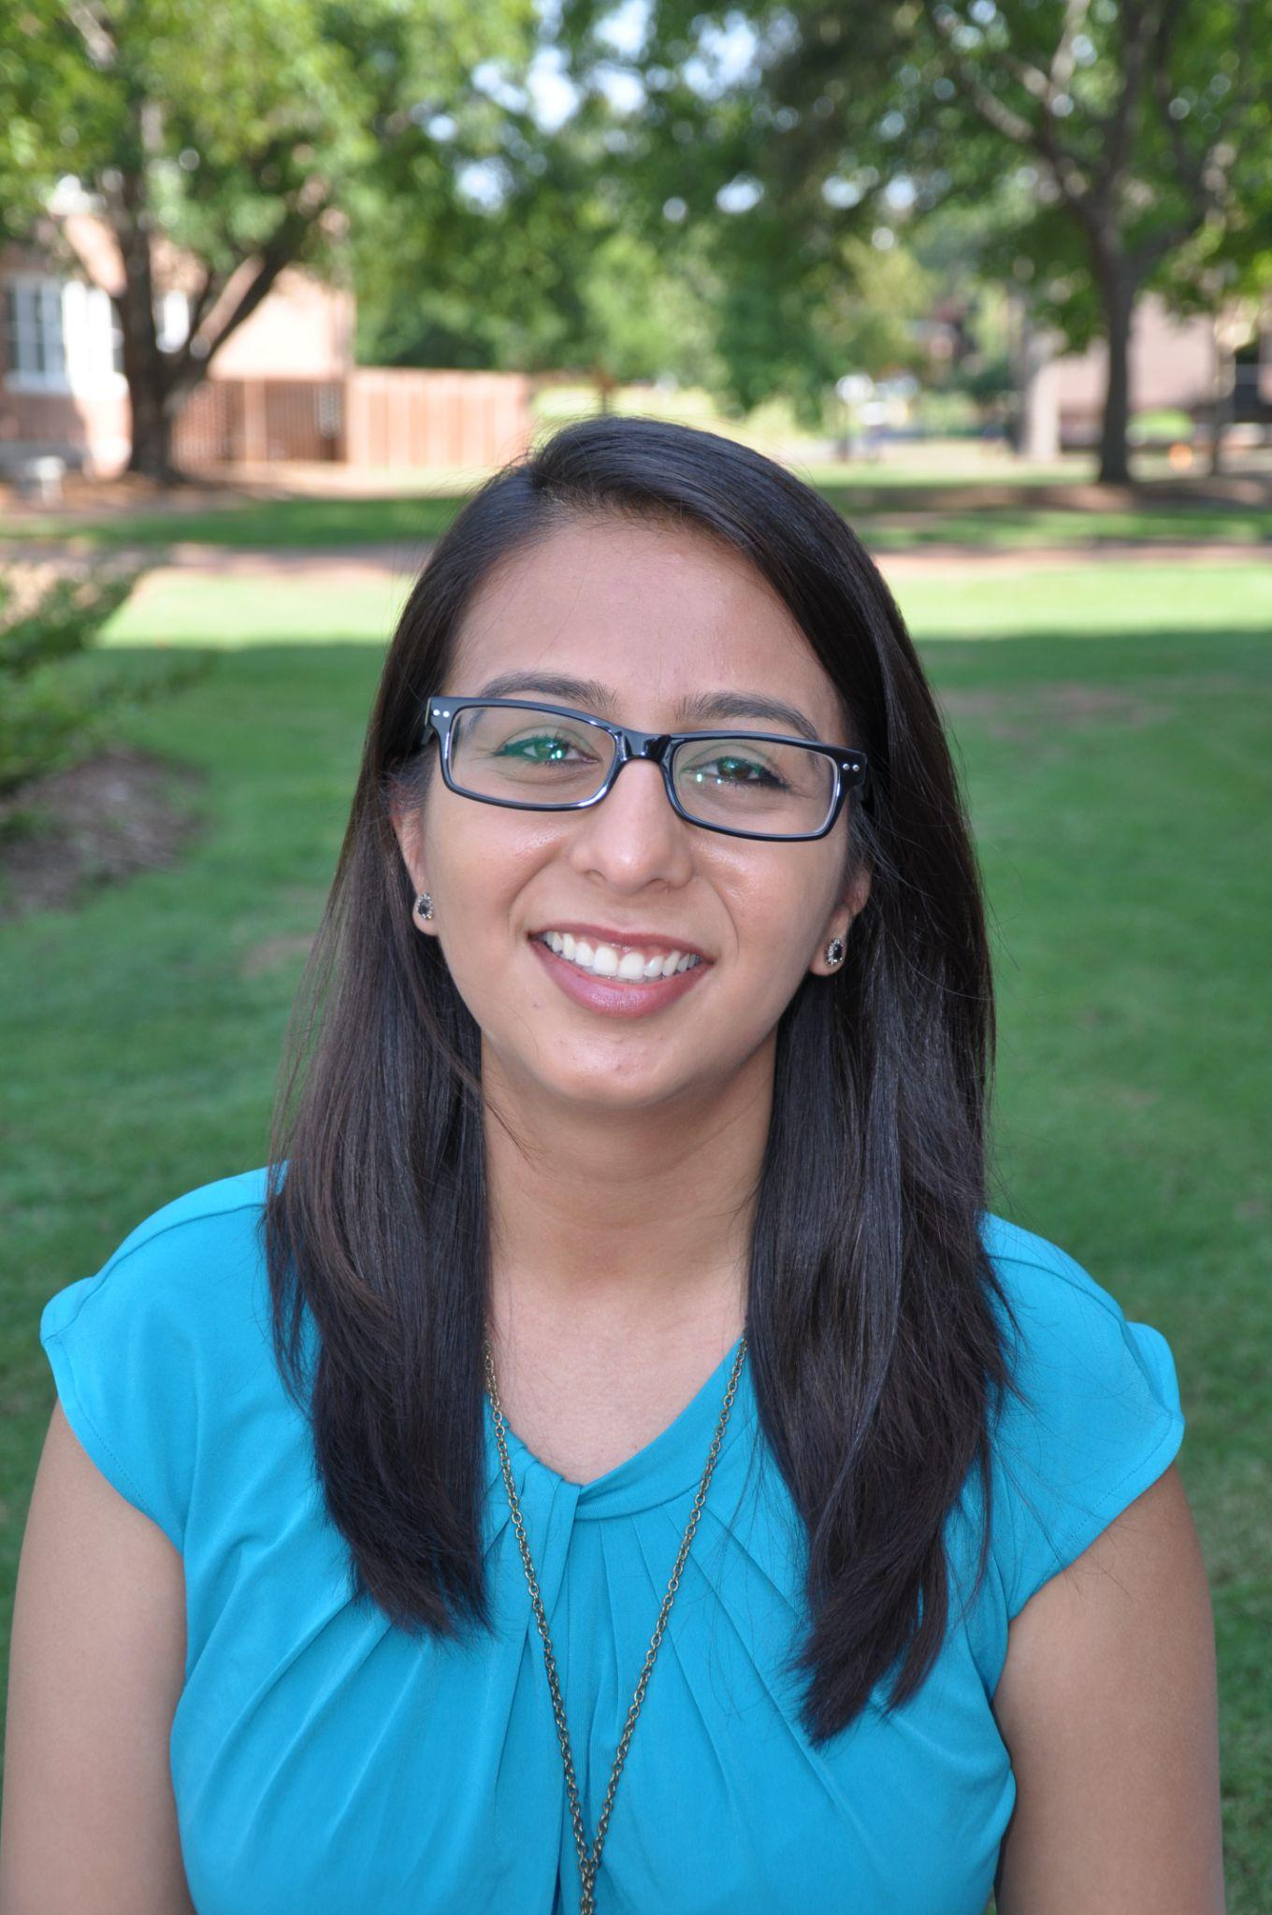
CPHS Roles in Healthcare Event
PASA Presents:
Featuring...
Dr. Paul DiMondi, PharmD
Morgan Dailey, PA-C, MSPH
Dr. Leah Main, PT, DPT
Allison Beam, PA-C
Dr. Manali Patel, PharmD
When: September 7th, 2021 6pm
Where: Zoom
Join us to learn more about what these alumni have been up to since graduating from CPHS!
Questions?
Contact Heather Faulkner
hdfaulkner0504@email.campbell.edu

